Slide 1

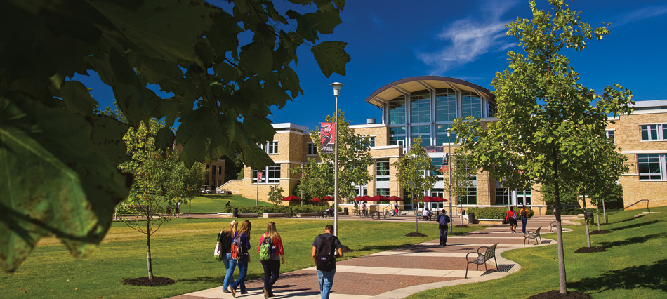

Reporting and Archiving in Taskstream
Summer 2020 Workshop: Taskstream Series #11
presented by: Mary Elizabeth Spence
July 30, 2020
AState.edu
/ArkansasState
@ArkansasState

Slide 2



Workshop Procedures
Welcome and thank you for participating in our Summer Workshop Series!
You will be muted upon entry to the workshop, so please introduce yourself via the Chat feature by clicking “Chat.”
The window to the right will appear where you can add your introduction:
If you have questions during the session, please add them to the Chat box and at the conclusion of our time we will include them in the Q and A.
AState.edu
/ArkansasState
@ArkansasState

Slide 3
Workshop Agenda
Attendees will be able to:
Run reports by Program Workspace for the following:
Alignment between Outcome Sets
Assessment Detail and Summary of Annual Cycles
Use these reports for internal and/or external assessment and accreditation reporting
Use the Archive Documents space to save all internal and/or external assessment and accreditation documents
AState.edu
/ArkansasState
@ArkansasState

Slide 4
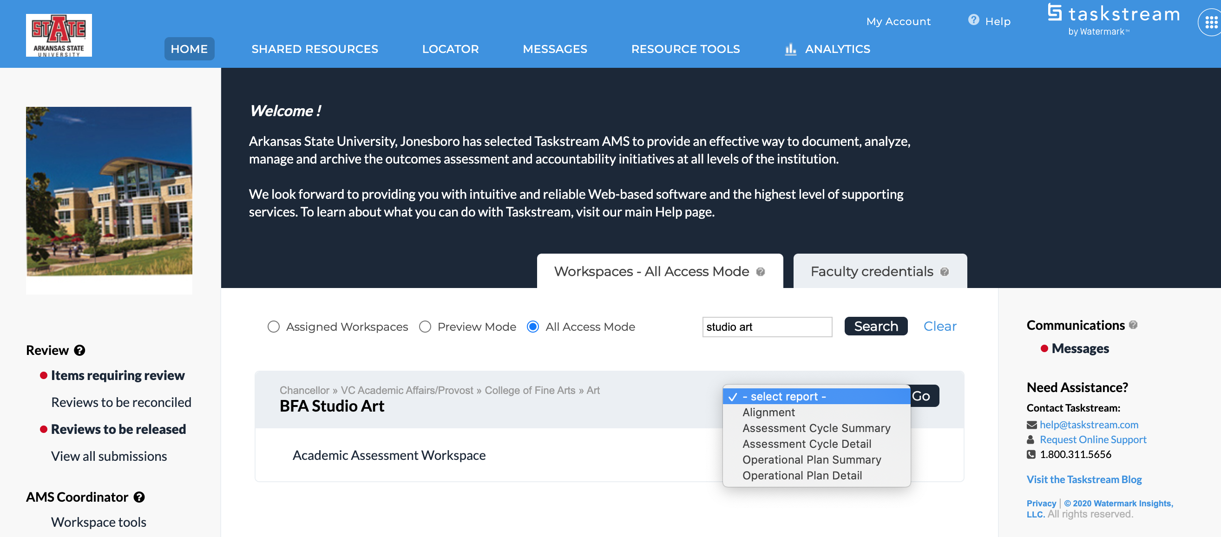

Taskstream Welcome Screen
This screen will show any Programs that you have access to view/edit.
AState.edu
/ArkansasState
@ArkansasState

Slide 5
Taskstream Welcome Screen
This screen will show any Programs that you have access to view/edit.
AState.edu
/ArkansasState
@ArkansasState

Slide 6
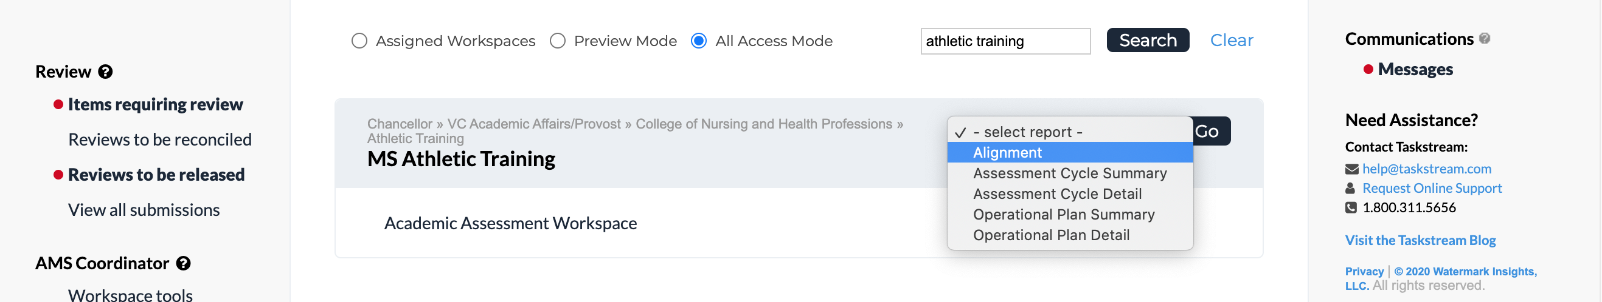
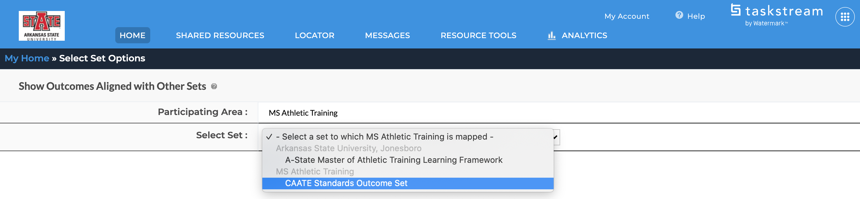
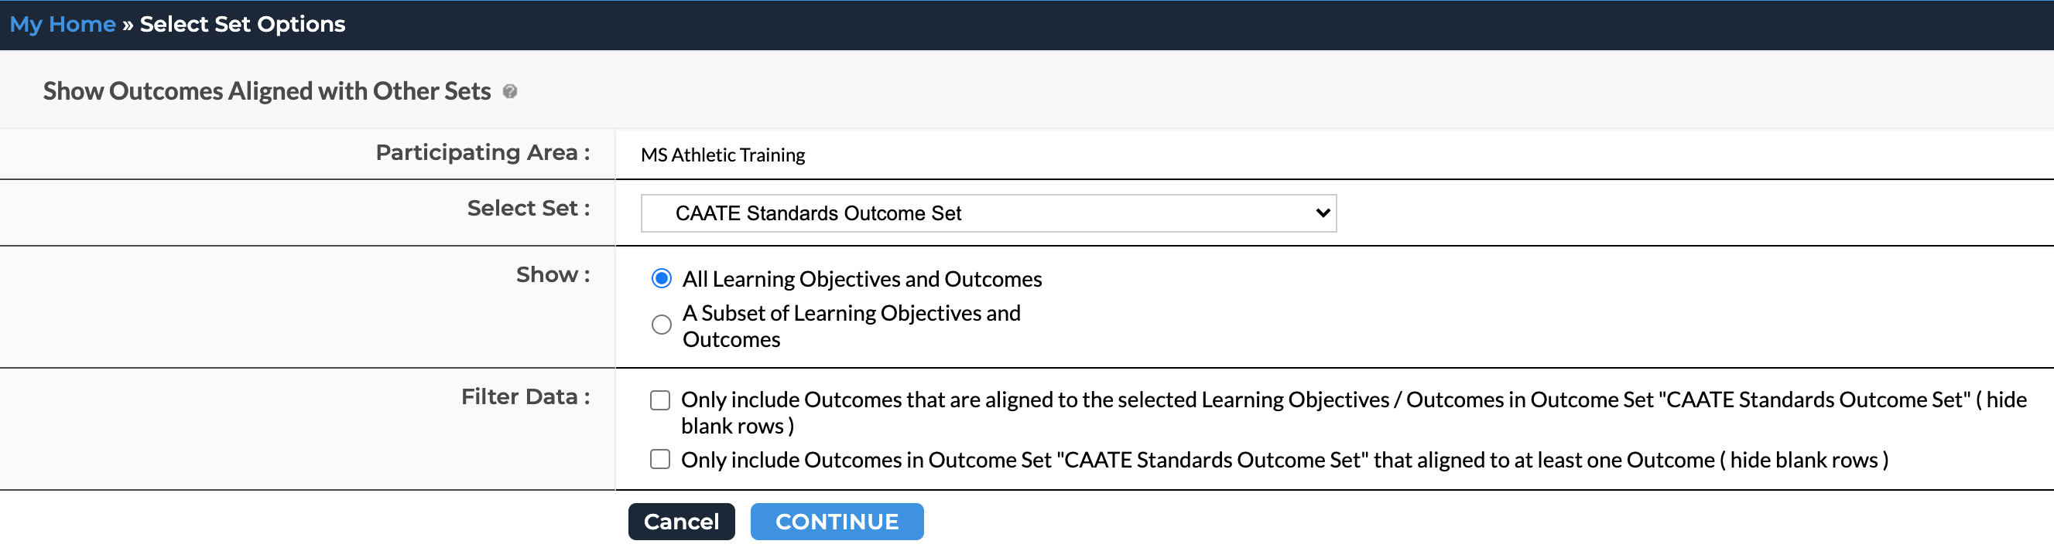
Taskstream Reporting Menu
Alignment Report
Step 1:
Step 2:
Step 3:
AState.edu
/ArkansasState
@ArkansasState

Slide 7
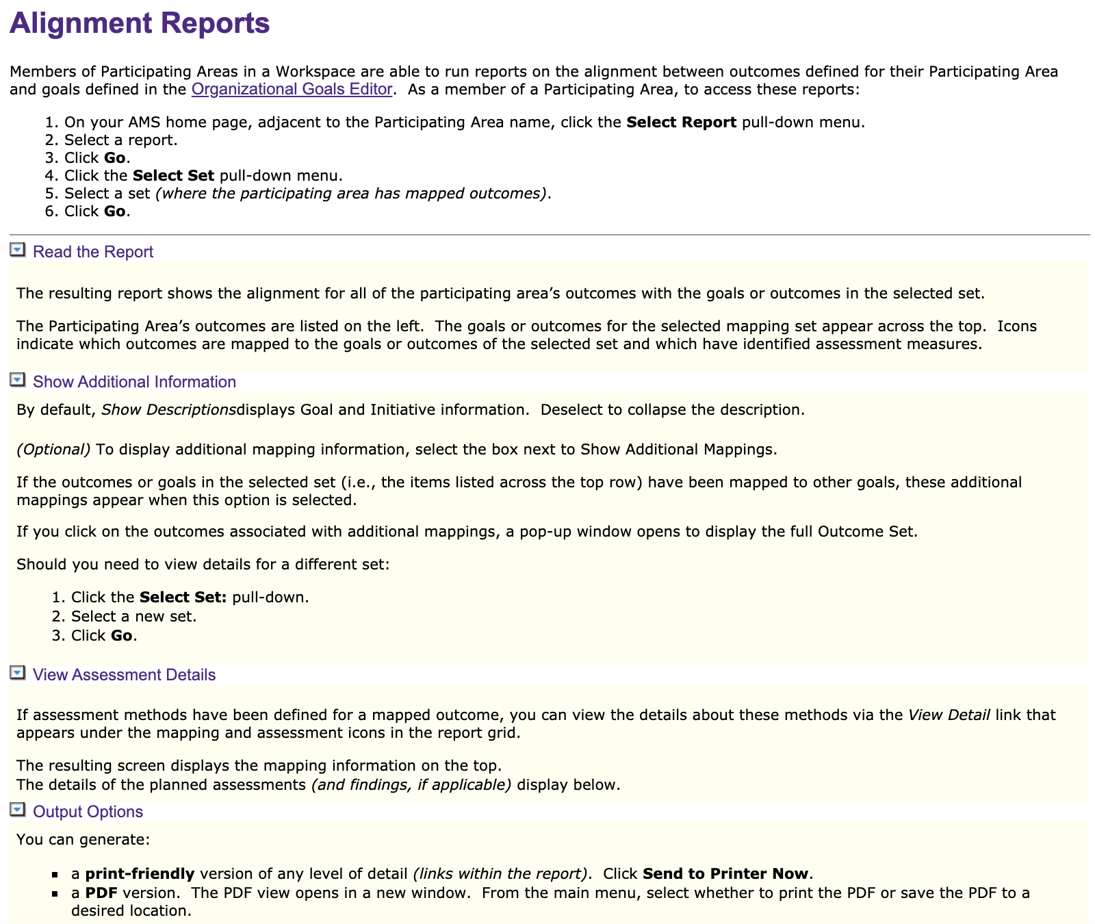
Alignment Report
AState.edu
/ArkansasState
@ArkansasState

Slide 8
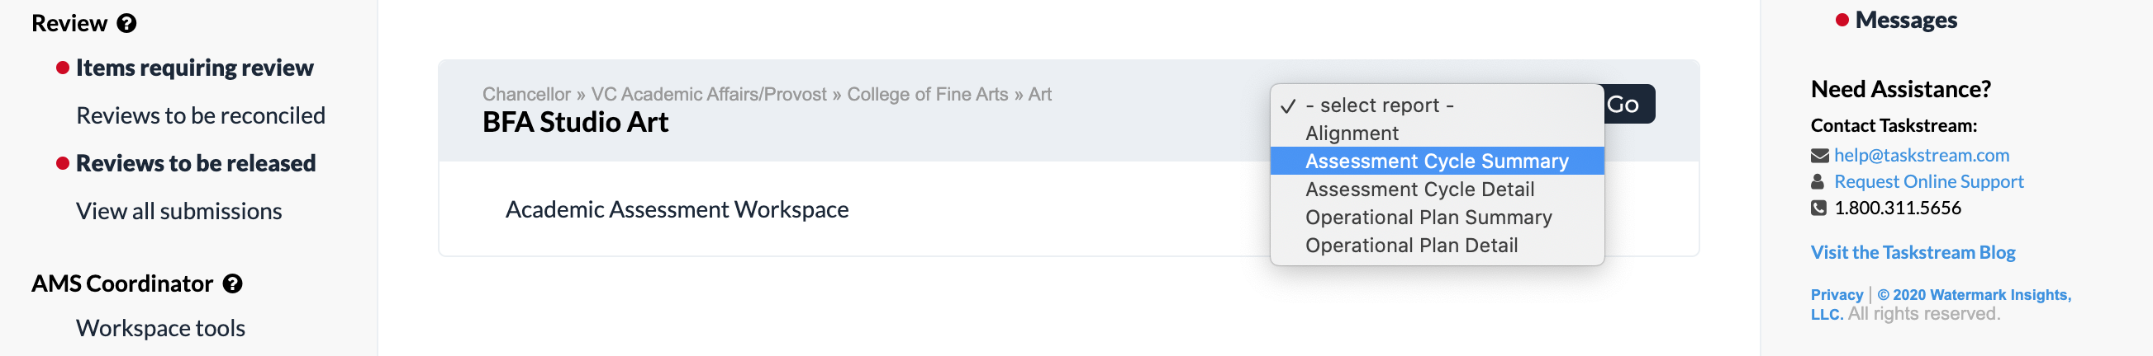
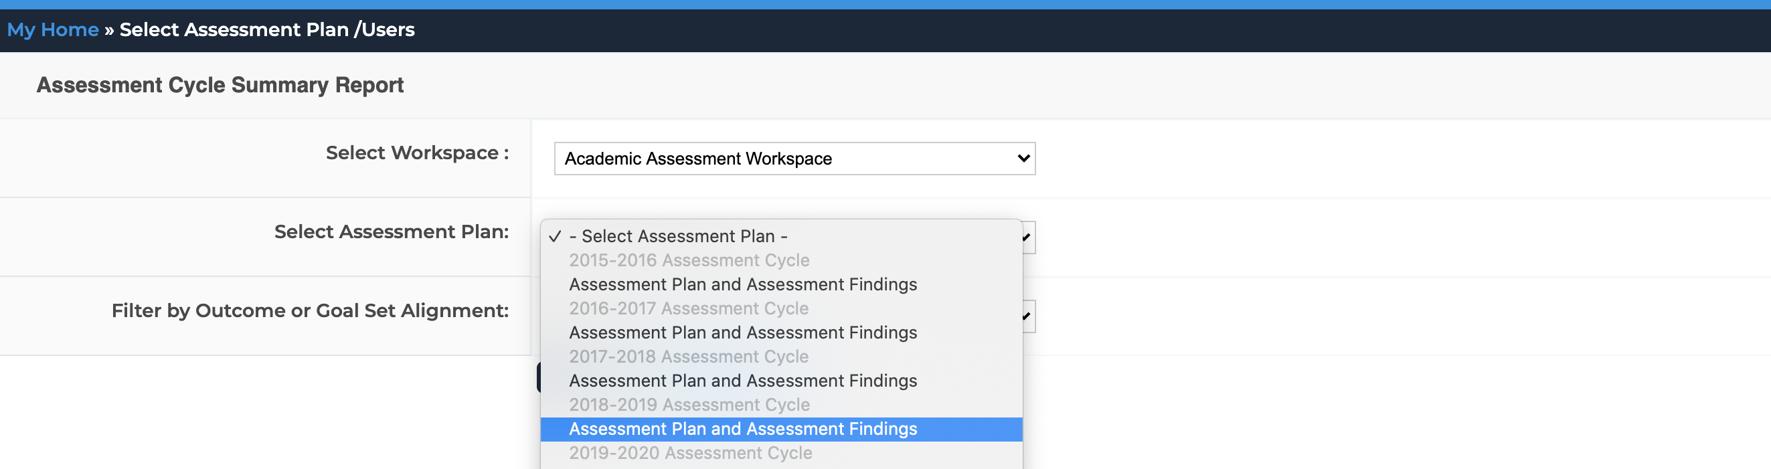
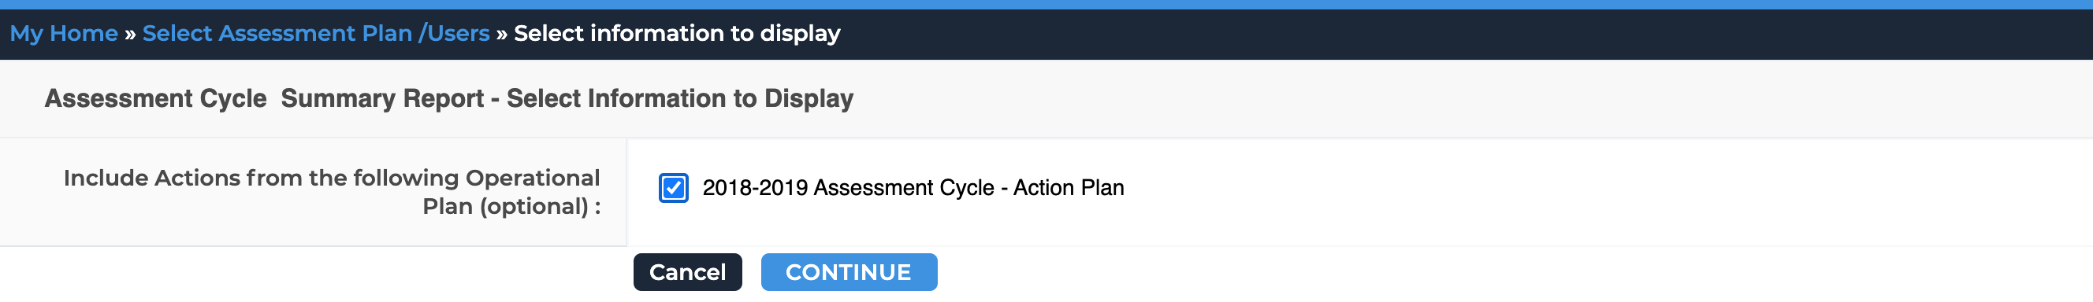
Taskstream Reporting Menu
Assessment Cycle Summary Report
Step 1:
Step 2:
Step 3:
AState.edu
/ArkansasState
@ArkansasState

Slide 9
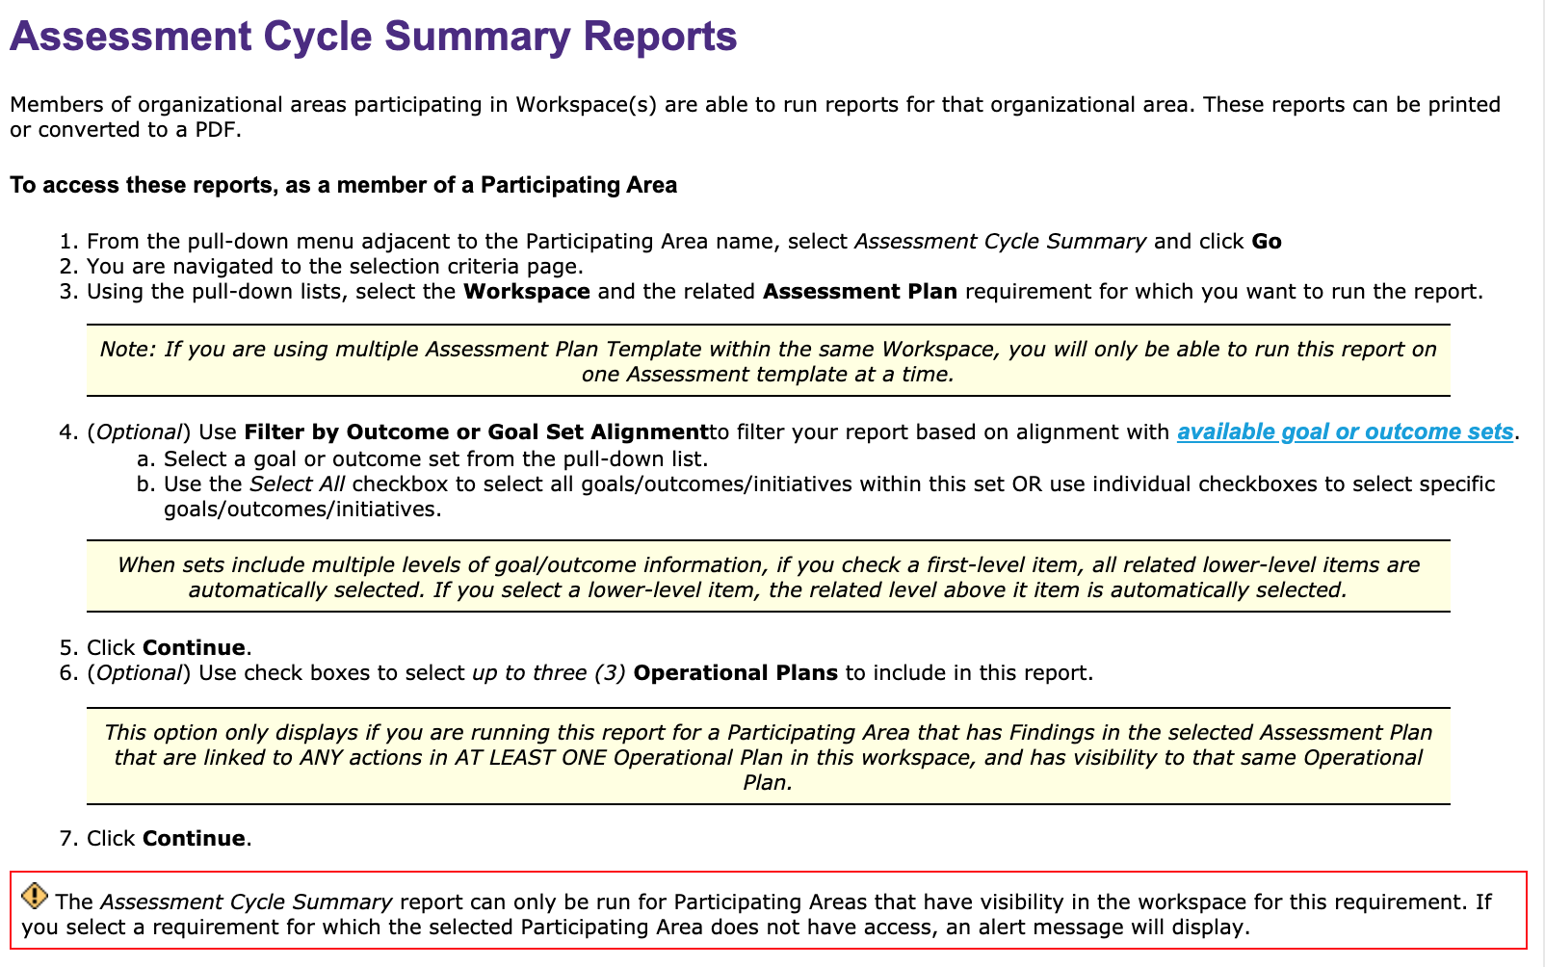
Assessment Cycle Summary Report
AState.edu
/ArkansasState
@ArkansasState

Slide 10
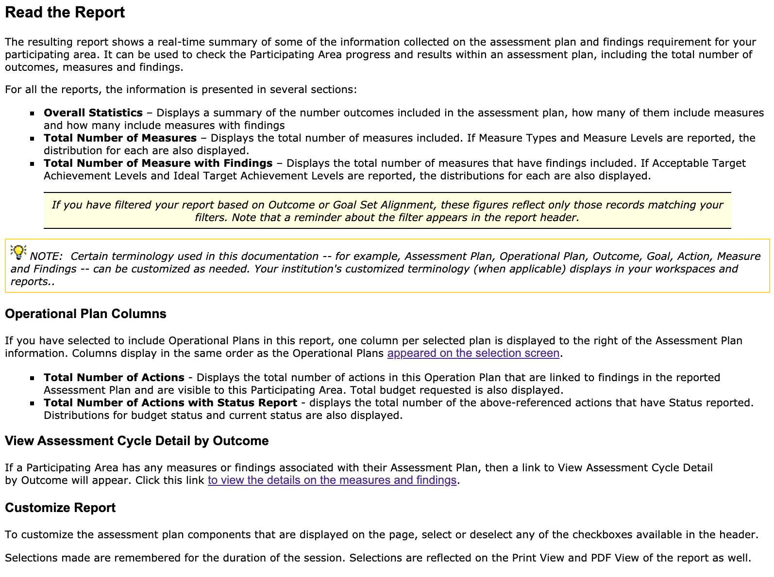
Assessment Cycle Summary Report (con’t)
AState.edu
/ArkansasState
@ArkansasState

Slide 11
Taskstream Reporting Menu
Assessment Cycle Detail Report
Step 1:
Step 2:
Step 3:
AState.edu
/ArkansasState
@ArkansasState

Slide 12
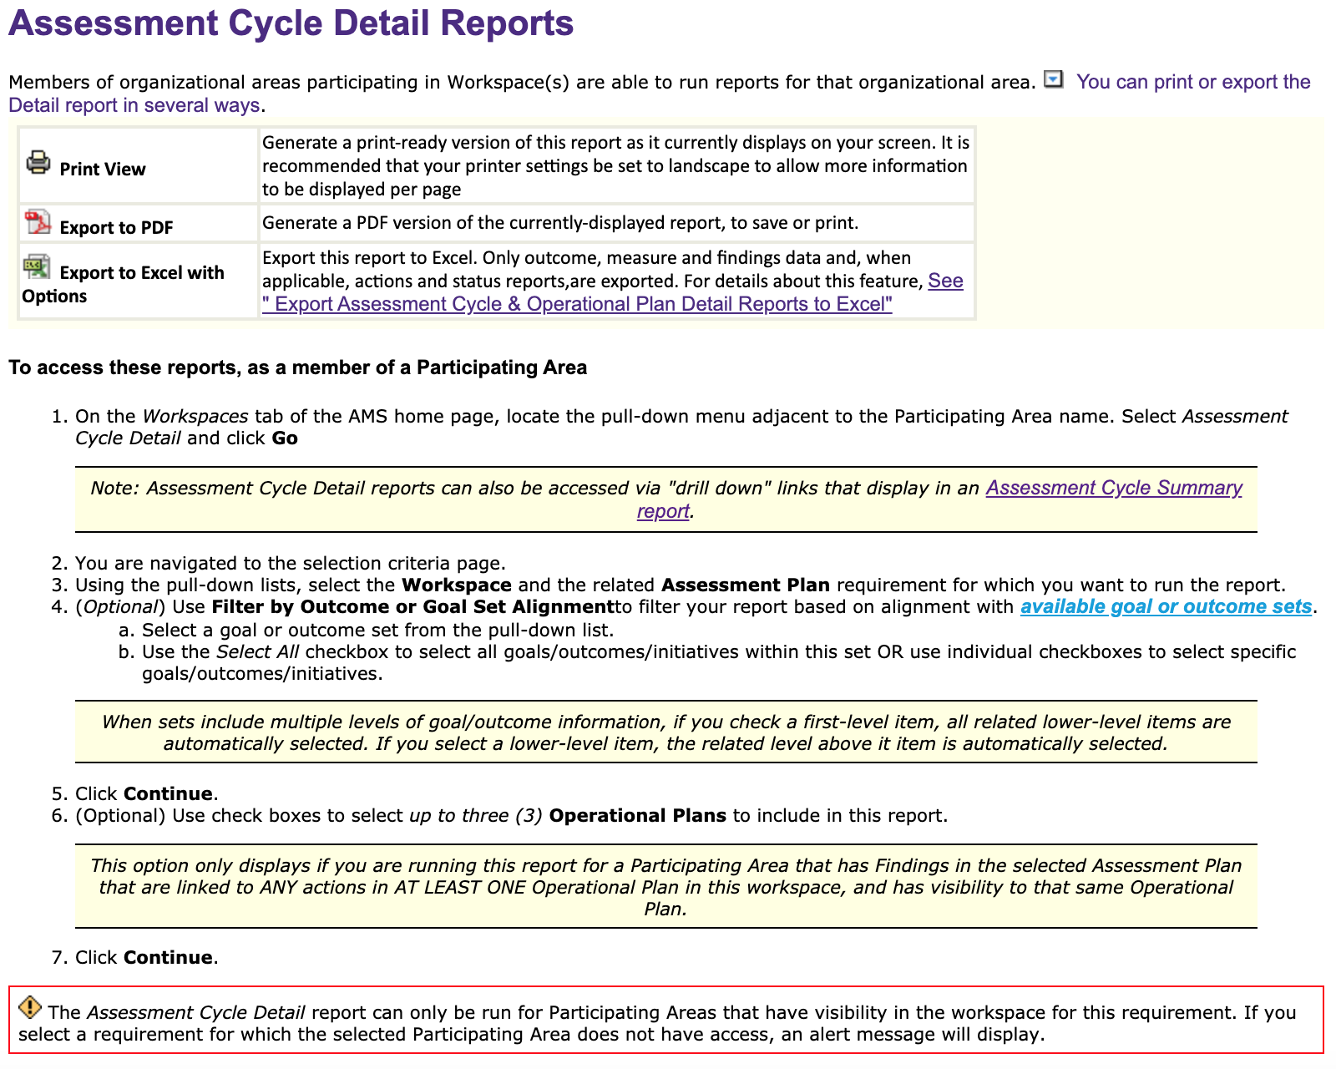
Assessment Cycle Detail Report
AState.edu
/ArkansasState
@ArkansasState

Slide 13
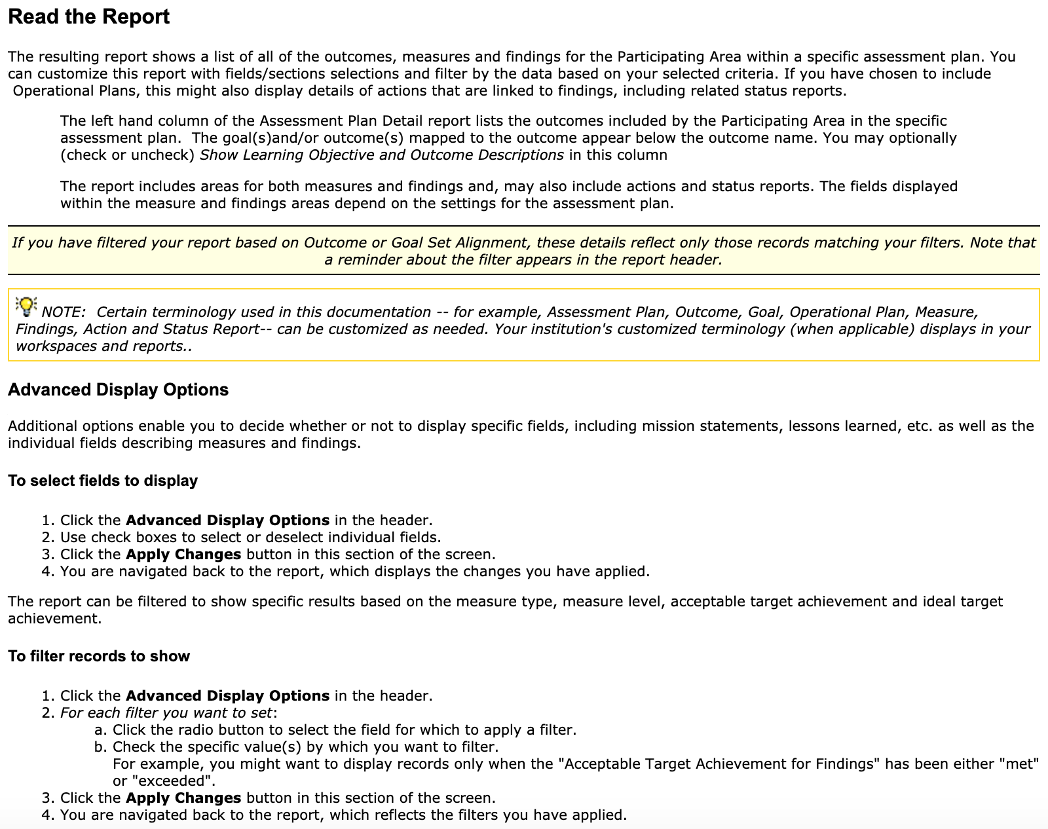
Assessment Cycle Detail Report (con’t)
AState.edu
/ArkansasState
@ArkansasState

Slide 14
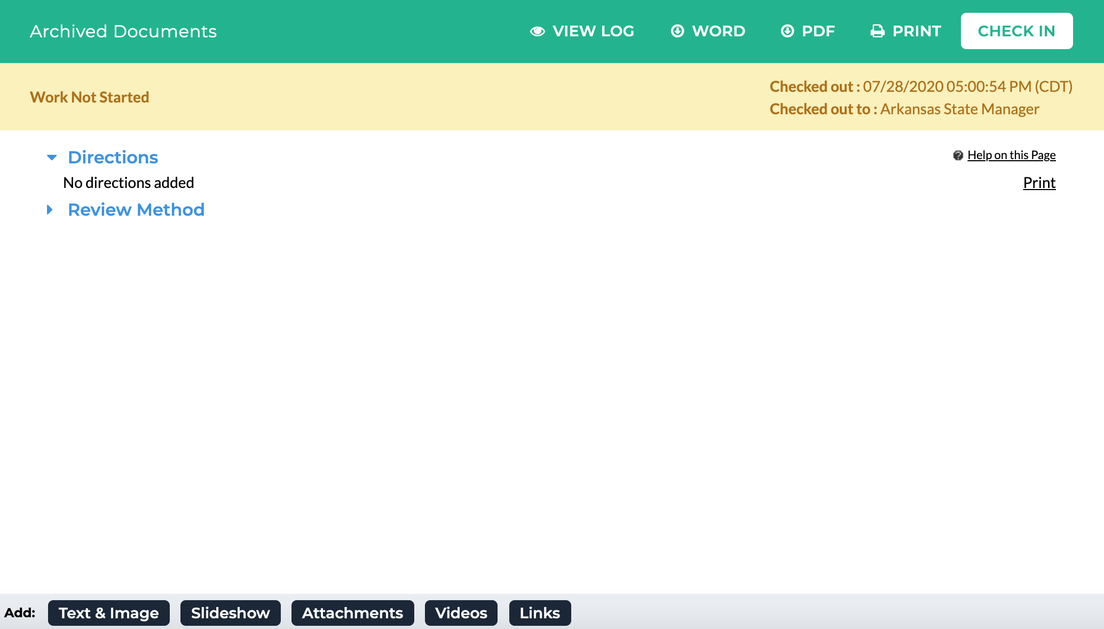
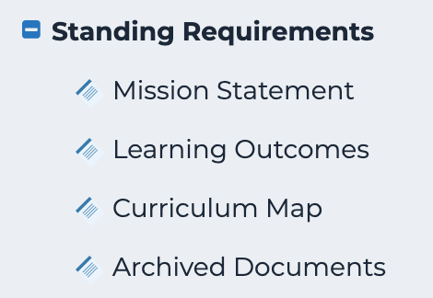
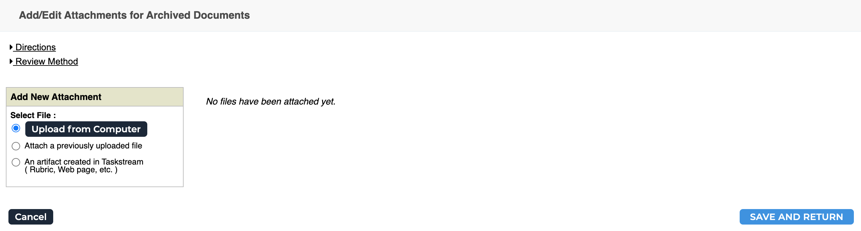
Archived Documents
Step 2:
Step 1:
Step 3:
AState.edu
/ArkansasState
@ArkansasState

Slide 15
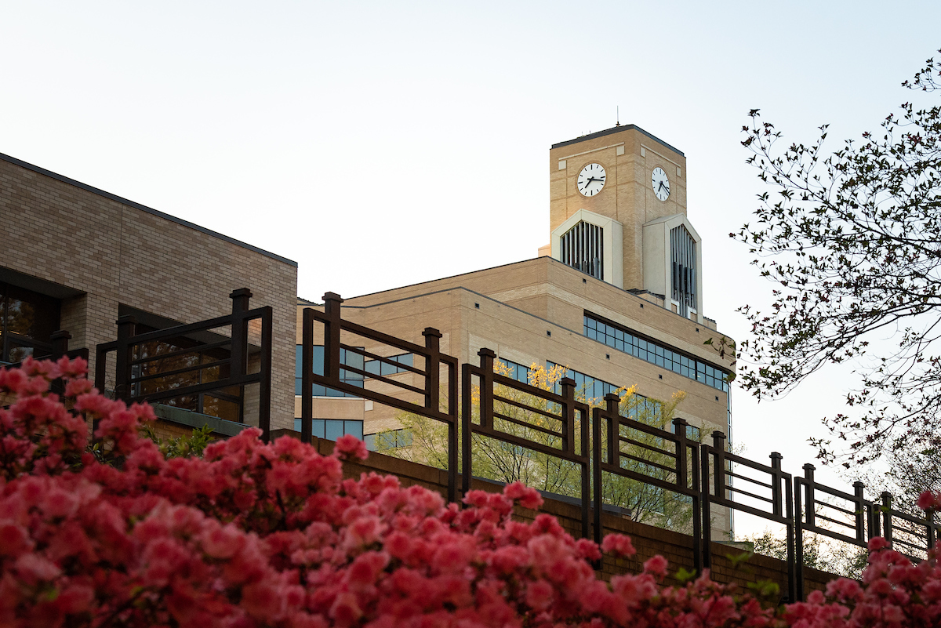
Session Q & A
AState.edu
/ArkansasState
@ArkansasState

Slide 16

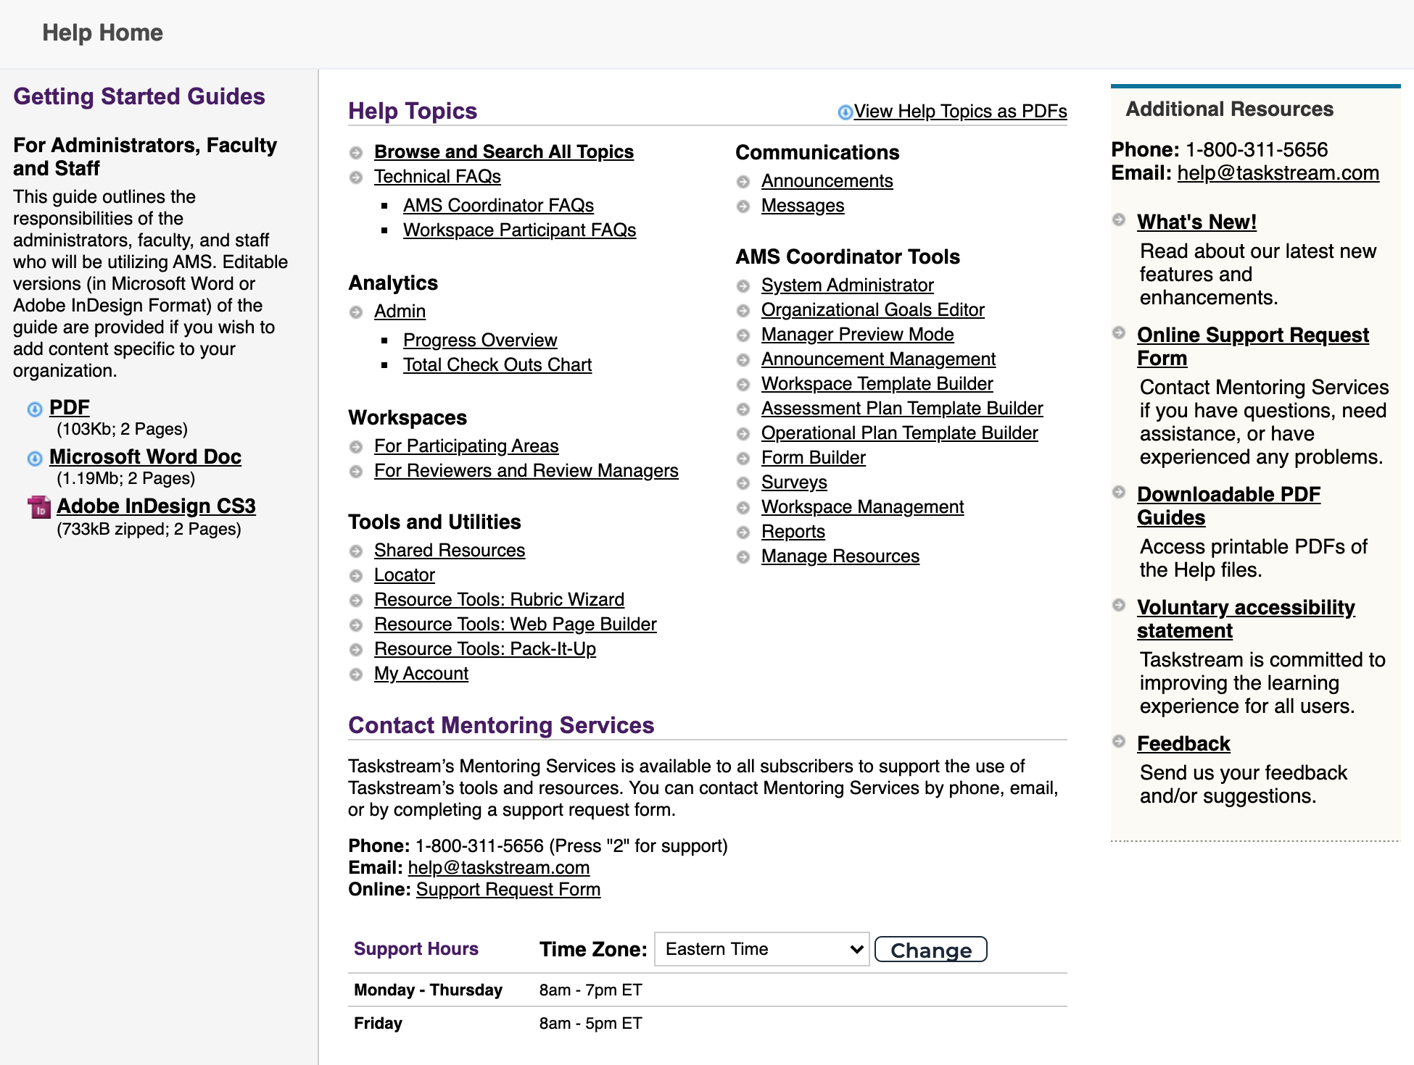
Taskstream Help
For “after hours” assistance, Taskstream has a number of great resources including contact by email and phone and a substantial set of guides. All can be accessed by clicking “? Help”:
AState.edu
/ArkansasState
@ArkansasState

